Slide 1
Subsurface Scattering
Xin Cheng

Slide 2
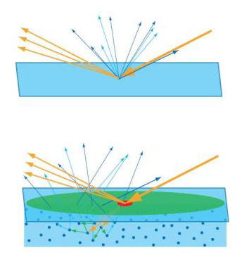
What is Subsurface Scattering
Translucency : light travels through an object's surface rather than simply bouncing off the surface.
When light transports below the surface of a translucent object, it will be scatted by interacting with the material, and exits the surface at a different point.
This is Subsurface Scattering (or SSS), also known as Subsurface Light Transport (SSLT).

Slide 3
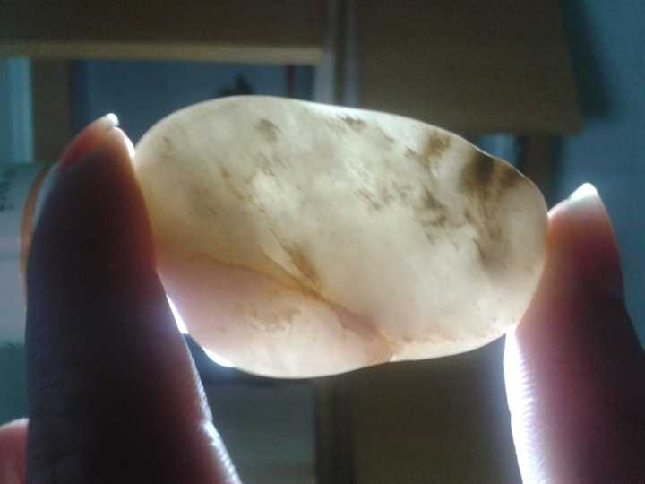
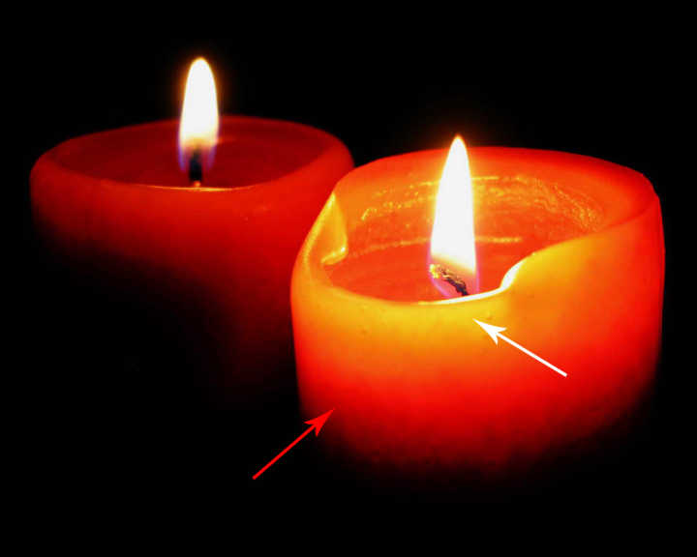

Slide 4
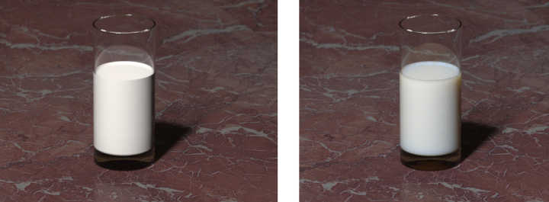
Using
Capture the true appearance of translucent materials
Such as skin, milk, wax, marble, paper, cheese, meat, plants......

Slide 5
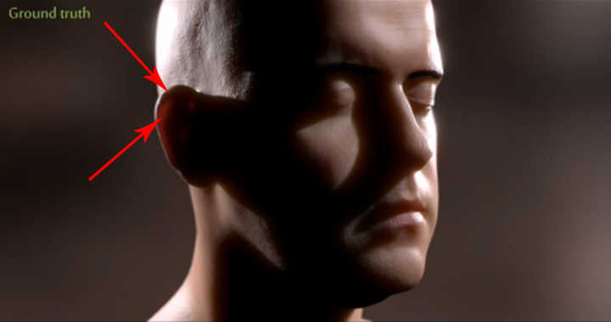
Using
Capture the true appearance of translucent materials
Such as skin, milk, wax, marble, paper, cheese, meat, plants......

Slide 6
Theory
BRDF → BSSRDF
Bidirectional Reflectance Distribution Function (BRDF) assume that light entering a material leaves the material at the same point. It’s valid for metals, but fails for translucent materials.
Bidirectional Surface Scattering Distribution Function (BSSRDF) can describe light transport between any two rays that hit a surface.

Slide 7
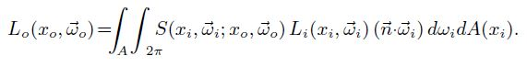
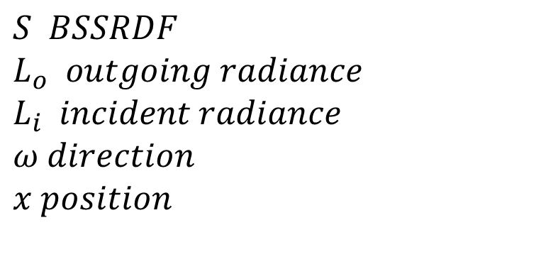
BSSRDF
$S BSSRDF$
$L_{o} outgoing radiance$
$L_{i} incident radiance$
$ω direction$
$x position$

Slide 8
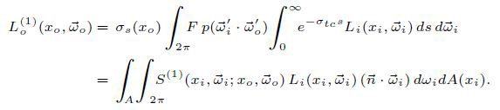
BSSRDF
Diffusion term of BSSRDF :
Single Scattering Term of BSSRDF

Slide 9
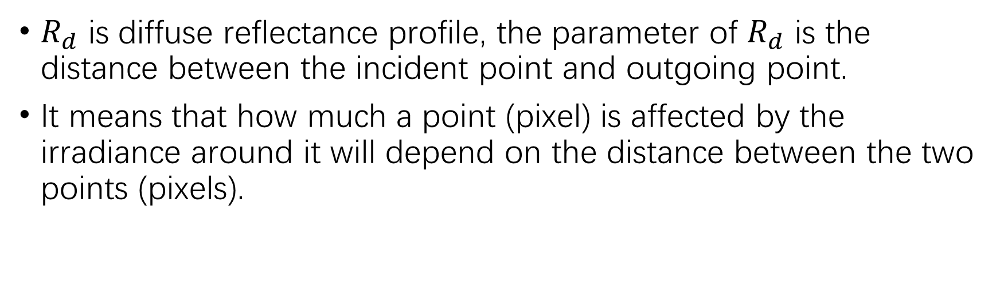
BSSRDF
Diffusion term of BSSRDF :
$R_{d}$ is diffuse reflectance profile, the parameter of $R_{d}$ is the distance between the incident point and outgoing point.
It means that how much a point (pixel) is affected by the irradiance around it will depend on the distance between the two points (pixels).

Slide 10
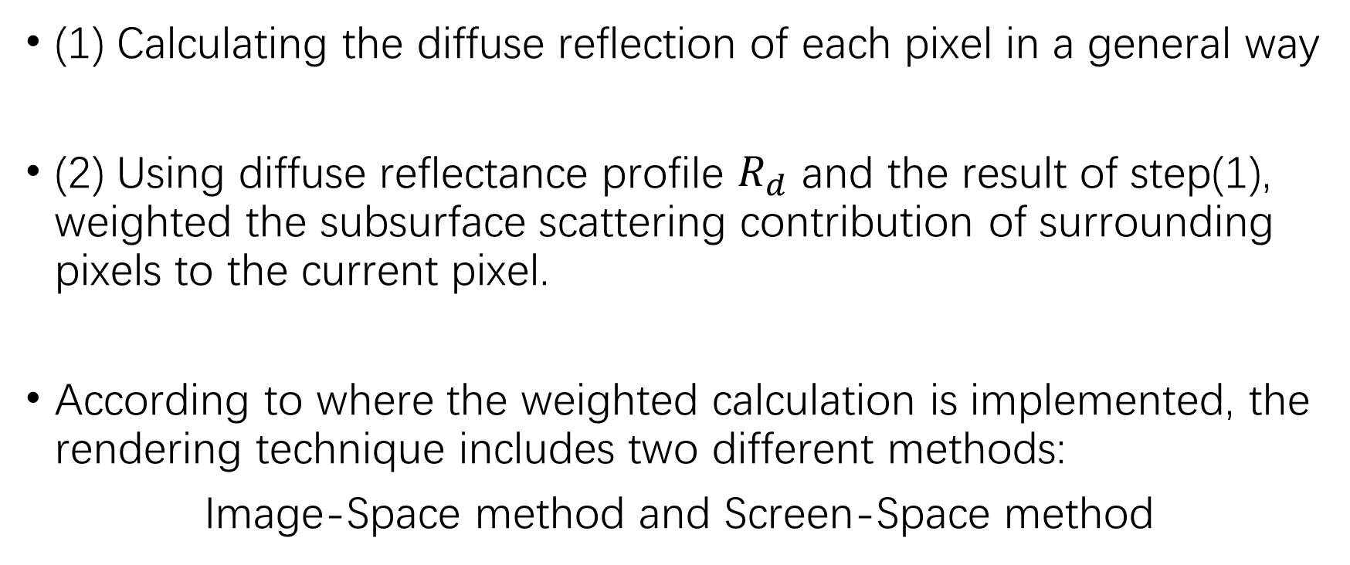
Two Steps
(1) Calculating the diffuse reflection of each pixel in a general way
(2) Using diffuse reflectance profile $R_{d}$ and the result of step(1), weighted the subsurface scattering contribution of surrounding pixels to the current pixel.
According to where the weighted calculation is implemented, the rendering technique includes two different methods:
Image-Space method and Screen-Space method

Slide 11
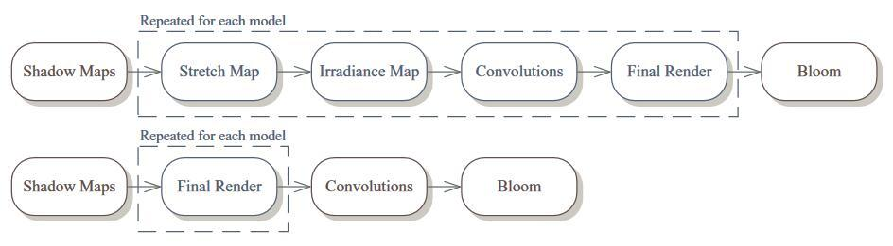
Image-Space method and Screen-Space method

Slide 12
Skin Subsurface Scattering
(Jimenz, “Screen-Space Perceptual Rendering of Human Skin”, 2009)

Slide 13
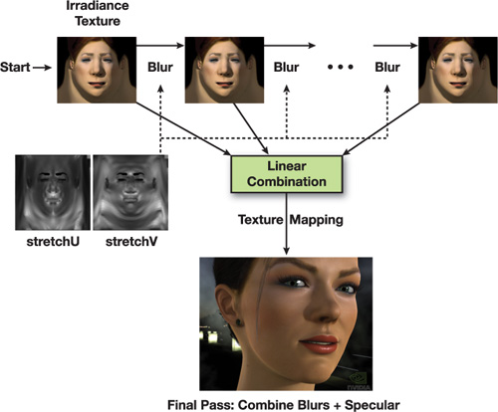
Image Space
Using UV coordinates and texture map
Calculate diffuse reflection, get irradiance map
Convolution on irradiance map (blur)
Convolution results + specular
Not efficient, high memory costs
(GPU Gems 3, Chapter 14)

Slide 14
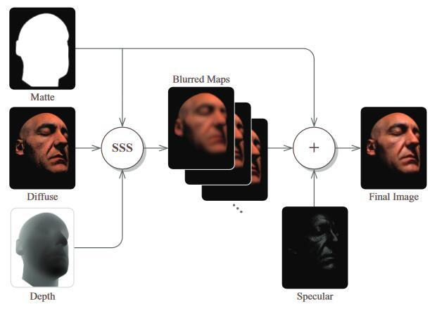
Screen Space
The only difference is the space, using projection coordinates instead of UV coordinates.
Not efficient, high memory costs
(Jimenz, “Screen-Space Perceptual Rendering of Human Skin”, 2009)

Slide 15
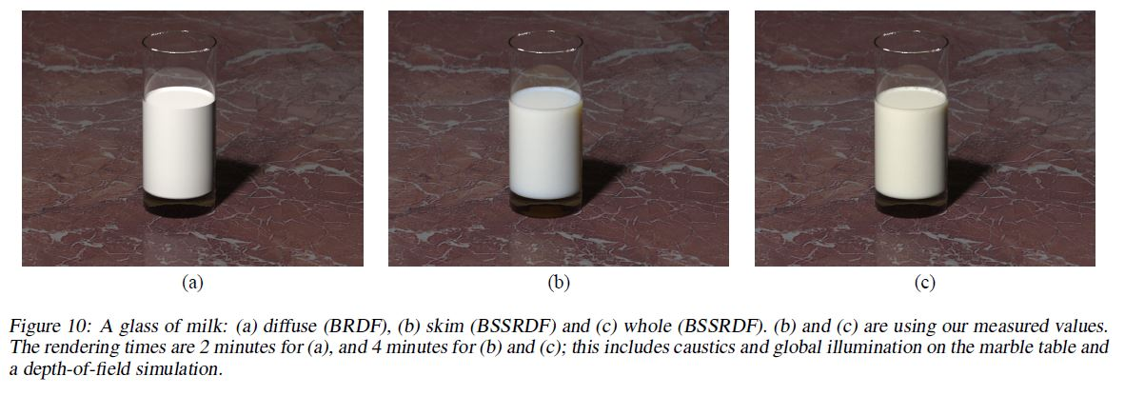
Published Results
Jensen, Henrik Wann, Stephen R. Marschner, Marc Levoy, and Pat Hanrahan. "A practical model for subsurface light transport." In Proceedings of the 28th annual conference on Computer graphics and interactive techniques, pp. 511-518. ACM, 2001.

Slide 16
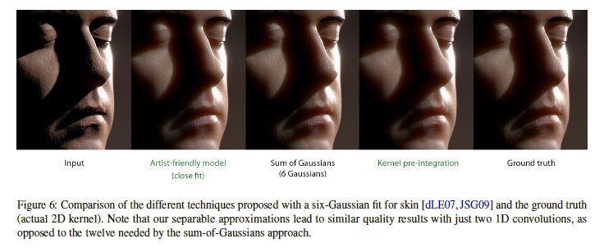
Published Results
Jimenez, Jorge, Károly Zsolnai, Adrian Jarabo, Christian Freude, Thomas Auzinger, Xian‐Chun Wu, Javier der Pahlen, Michael Wimmer, and Diego Gutierrez. "Separable subsurface scattering." In Computer Graphics Forum, vol. 34, no. 6, pp. 188-197. 2015.

